Slide 1
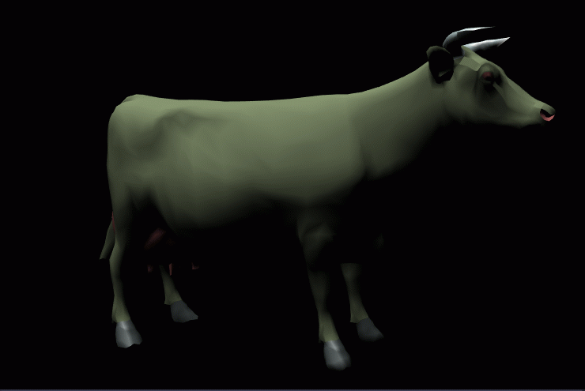
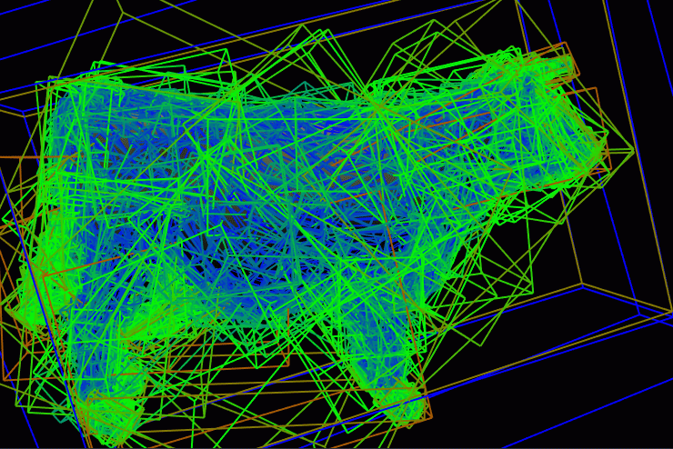
Proximity Queries
Eric Meisner
11/11/2003

Slide 2
References
Eric Larsen, Stefan Gottschalk, Ming C. Lin, Dinesh Manocha Fast Proximity Queries with Swept Sphere Volumes Technical report TR99-018 1999 University of North Carolina Chapel Hill Department of Computer Science 1999.
Brian Mirtich V-Clip: Fast and Robust Polyhedral Collision Detection Mitsubishi Electric Research Laboratory. ACM Transactions on Graphics, July 1997.

Slide 3
Problems
Collision Detection - given two models, is there geometric contact
Separation Distance – what is the minimum Euclidean distance between two models
Approximate Distance – Find the distance between two models with some precision

Slide 4
Applications
Graphics
Robotics
Physically based modeling
Computer animation
Dynamic Simulations

Slide 5
Researched Methods
Distance computation: Given two polytopes, how to find their distance quickly
Hierarchical Data Structures: What types of bounding volumes, or combinations of bounding volumes are efficient

Slide 6
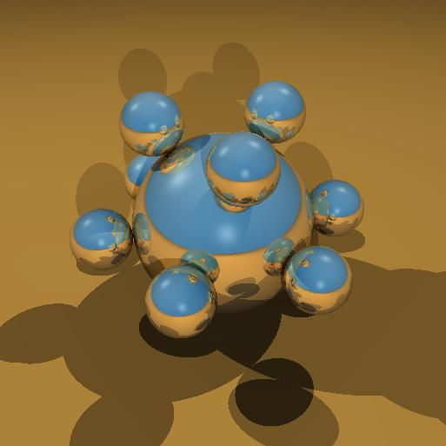
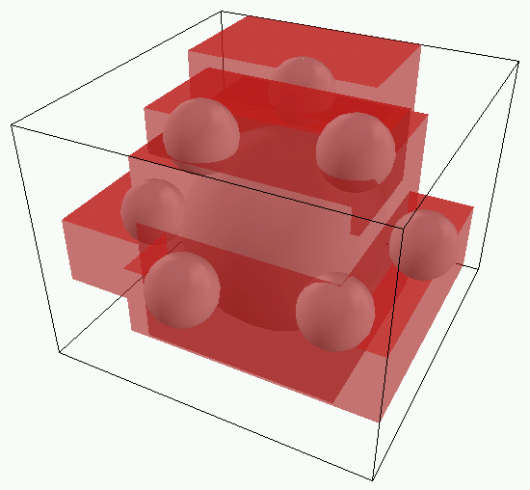
Bounding Volumes and Bounding Volume Hierarchies
Bounding volumes (BV’s) are shapes used to enclose sets of primitives
A bounding volume hierarchy (BVH) is a tree structure used to store BV’s in nodes. The root contains all primitives of a model. Children contain portions of the model and leaves (usually) contain a single primitive

Slide 7
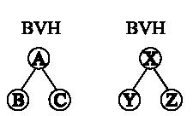
Using BVH for Collision Detection
For two models, traverse their BVH’s in
tandem and successively check nodes for
overlap. If leaves are reached, compare the
primitives directly

Slide 8

Using BVH’s for Proximity Queries
Same for Proximity Queries but, an extra
parameter is required to keep track of
minimum distance.

Slide 9
Basic Idea
The distance between two bounding volumes gives a lower bound on the distance between any of their children
If the bounding volumes are not in collision, the children are not in collision.
If the distance between bounding volumes is > epsilon, then the algorithm can stop searching for collisions.

Slide 10
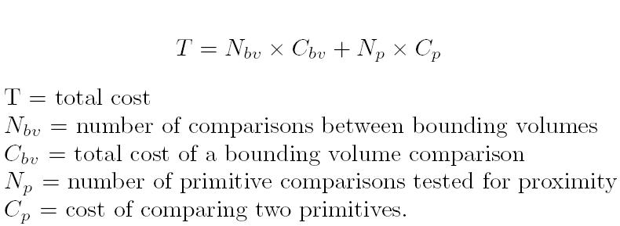
Cost Analysis
The cost function serves as a guideline when designing a scheme for bounding volumes:

Slide 11
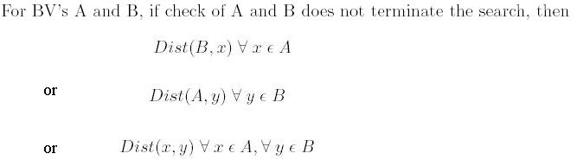
Parameters
Tree building method
Branching factor
There are 3 possible rules for comparing to BVH in tandem:

Slide 12
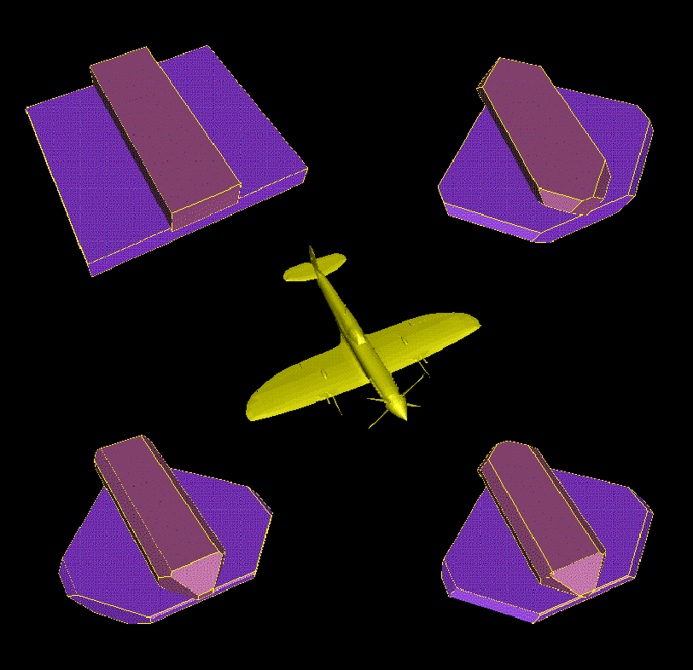
Trade offs in selection of BHV
Tighter fit ⇨increased cost of comparison
Low complexity Polygons ⇨ fast comparison but requires more BV’s
For complex polygons (N-sub-bv) and N-sub-p are lower and C-sub-bv is higher

Slide 13
Implication
No bounding volume is optimal for all situations.
The solution is to use hybrid hierarchies, which include several types of BV’s
This allows varying degrees of tightness of enclosure.

Slide 14
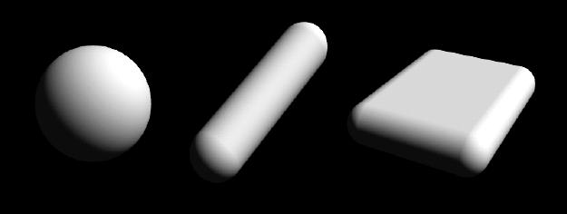
PQP
(Proximity Query Package)
Larsen, Gottschalk, Lin, and Manocha
Use a hybrid BVH, which consists of different swept sphere volumes

Slide 15
Swept Sphere Volumes
Swept sphere volumes are generated by taking the Minkowski sum of a core primitive and a sphere
Point Swept Sphere- point and radius
Line Swept Sphere- Line segment, a center and a radius
Rectangle swept sphere- Rectangle , a center and a radius

Slide 16
Swept Sphere Volumes
Point Swept Sphere (pss)
  Smallest sphere that captures some set of points.
  Works well for symmetric objects.
  Linear convergence on enclosed region
Line Swept Sphere(lss)
  Largest dimension of the region used as the center line
  Works well for objects with two axis of similar length, and elongated shapes
  Convergence is somewhere between pss and rss
Rectangle Swept Sphere(rss)
  Used for all other cases
  Provides tightest fit, quadratic convergence on enclosed region
  Smallest dimension of the region is used as the normal direction of the rectangle

Slide 17
Why Use Swept Sphere Volumes?
For a given swept sphere volume, you can perform the proximity query on the core primitive (point, line segment , Oriented bounding box) and then add the radius of the swept sphere.
The three volumes provide good variety in tightness of fit vs. speed

Slide 18
How to select the Swept Sphere Volume
Given a Model, and its enclosing bounding box,
  If all axes of the bounding box are similar in length, use a PSS volume
  If the object has two axes which are similar, and one long axis, use a RSS volume
  In all other cases use an RSS volume

Slide 19
Separation method
Given a model, how should it be separated into bounded polygons?
  Solution: Decompose the model into triangles and enclose them in one of the BV types
  This is done using a statistical technique which computes bounding volumes for each triangle
  The vertex coordinates are summarized using the mean μ and the covariance matrix C.

Slide 20
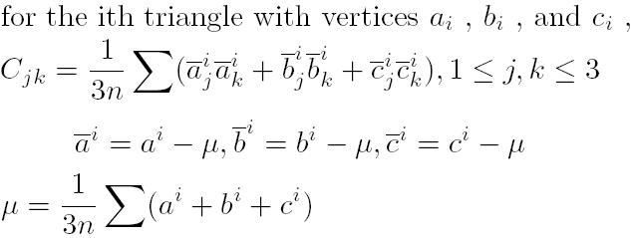
Mean and Covariance Matrix
Using the above equation to generate the Covariance matrix C, find the eigenvectors of C. These vectors provide axes along which are used to generate a bounding box.

Slide 21
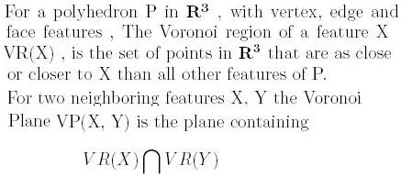
Voronoi Regions (revisited)

Slide 22
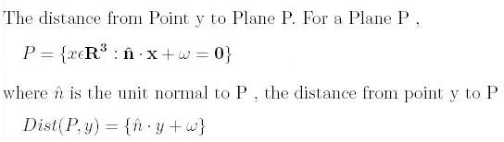
Distance point to plane

Slide 23
Using Voronoi Characteristics for Proximity Queries
Given two features A and B , and p the closest point on B to A,
  If B is entirely in the Voronoi region of A, then p is also in A’s voronoi region.
  If B is entirely outside of the Voronoi region of A, then p is also outside A’s voronoi region.
  If B is partially inside the voronoi region of A then p may or may not be in the voronoi region of A, and A and B may be colliding, test further

Slide 24
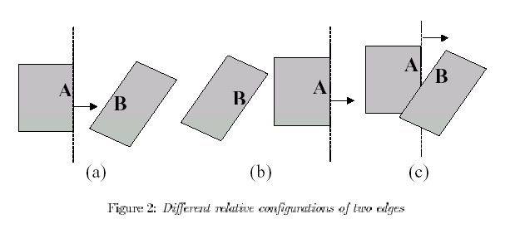

Slide 25
This is useful for proximity and collision detections because…
If p is not in the voronoi region of A, then A and B are not the closest features of their respective polygons. For proximity queries and collision detections, this reduces the number of BV comparisons
If B is totally inside or outside of A’s voronoi region, then A and B are not in collision
The PQP algorithm method takes advantage of this information to increase efficiency

Slide 26
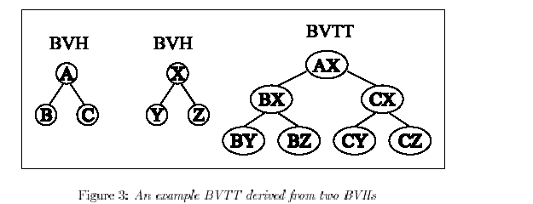
Bounding Volume Test Trees
The bounding volume test tree of two models, A and X represents the proximity queries performed the respective BVH’s of A and X

Slide 27
Pruning the BHTT
The bounding volume test tree works by caching the current closest features and their proximity, epsilon until epsilon reaches the minimum distance, δ
A pair of features A, X fails to update epsilon, when : Dist(A, X) > epsilon , and the algorithm terminates and epsilon = δ

Slide 28
Priority Directed Search
Problem: Make epsilon shrink to δ using the fewest number of comparisons
Solution: Use a priority queue for the BVTT
  For any level of the tree, the BV are compared in order of proximity
  This makes epsilon approach δ using the minimal number of comparisons and prunes the BVTT
  This is called a minimal BVTT

Slide 29
Applying the same idea to Collision Checking
Pruning conditions hold for collision checks.
For two models A and B, the exact distance query BVTT is equal to the collision check BVTT for models A and B

Slide 30

Approximate Distance Queries
Given an relative error tolerance R, the pruning condition becomes,

Slide 31
PQP features
Swept Sphere volumes, which we have seen to be efficient
Sophisticated method for bounding box computation
Priority Directed Search, using proximity among bounding volumes

Slide 32
V-clip:Fast and Robust Polyhedral Collision Detection
Mitsubishi Electric Research Laboratory
(MERL)

Slide 33
Lin-Canny
V-Clip is a closest feature algorithm which improves upon the Lin-Canny algorithm
Lin-Canny
  Does not handle penetration, or degenerate cases.
  In these cases, It requires an infinite cycle detector

Slide 34
What does V-Clip do?
Problem: Given two features of a polyhedron X and Y, determine the closest point on Y to X
  This is useful for collision checking and proximity queries
  This is especially difficult when Y is an Edge.
  V-Clip attempts to solve this problem for difficult edge cases

Slide 35
V-Clip
Advantages
  Handles penetration and degenerate cases
  Does not require numerical tolerances
  Minimizes the number of divisions required
  No infinite cycles
Drawbacks
  Does not work well for non-convex bodies, unless a convex hull can be generated quickly

Slide 36
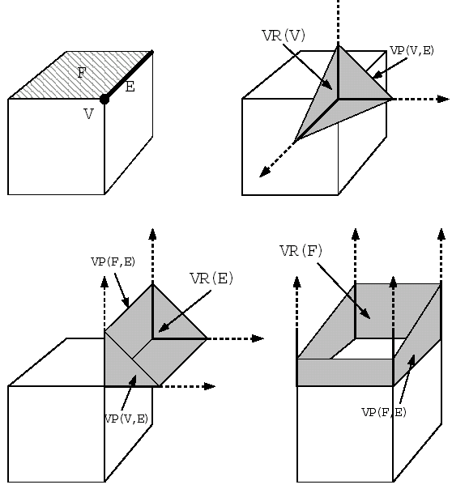
Topology of Voronoi Regions
(neighbor rules)
Neighbors of a vertex are edges incident to the vertex
Neighbors of a face are the edges bounding the face
Neighbors of an edge are its end points and the two faces it bounds

Slide 37
Updating a Feature
When comparing two features X and Y from two different polyhedra, determine if Y is in VR(X).
  If it is not, select a new feature to compare with X. This feature is selected based on which half-plane of VR(X) is violated by Y
  When updating, if the new feature is of higher dimension, then the distance to X should decrease
Special conditions apply if Y is an edge

Slide 38
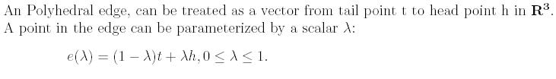

Point Clipping
For a feature X and Edge E if E passes through VR(X), then there is a segment along E
Where λt and λh are the points where E intersects the Voronoi planes of X, N and N

Slide 39
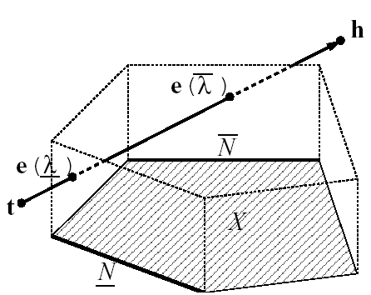
Clipping an Edge
  V-Clip computes λt , λh N and N
  If λt , λh = Ø , then the algorithm returns false, otherwise it returns true

Slide 40
Intersection Case
E is an edge and X is a polyhedral feature, p is the closest point on E to X
If edge E intersects a half-plane in VR(X) then , using the λh and λt,
  Determine the interval in E in which p lies
  This is done checking the sign of the derivative of the distance function Dist(X, E) at the points λh and λt.
Use this information to select which neighbor of X will be used to update X if necessary.

